Slide 1
Family Handbook - 2026
educare@Carlswald

Slide 2

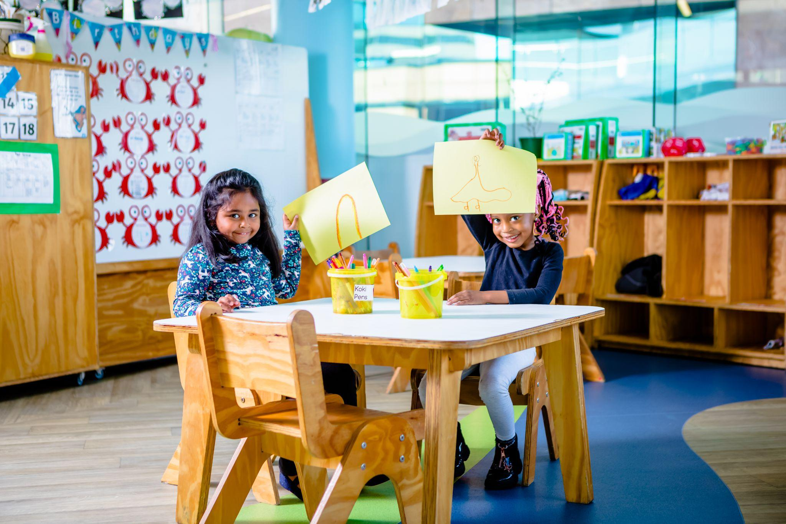
Welcome Message
Dear Parent or Guardian,
We are delighted that you are considering becoming part of the Earlybird@Carlswald family. Our programme is built on the foundation of nurturing young minds and fostering a love for learning from the very beginning. We understand how crucial the early years are in a child's development, and we are committed to providing a warm, supportive environment where your child can thrive.
Enclosed in this introductory pack is essential information to help guide you through what to expect at Earlybird. It covers our educational philosophy, daily routines, and how we collaborate with families to ensure your child receives the best start on their learning journey. We believe that education is a partnership, and we look forward to working together to create enriching experiences for your child.
If you have any questions or need further clarification, please don’t hesitate to contact us at carlswald@earlybirdeducare.com or give us a call at 060 659 0530.
Our dedicated team is here to support you every step of the way and ensure your child is ready for the exciting adventures ahead!
Meg and The Earlybird Team

Slide 3
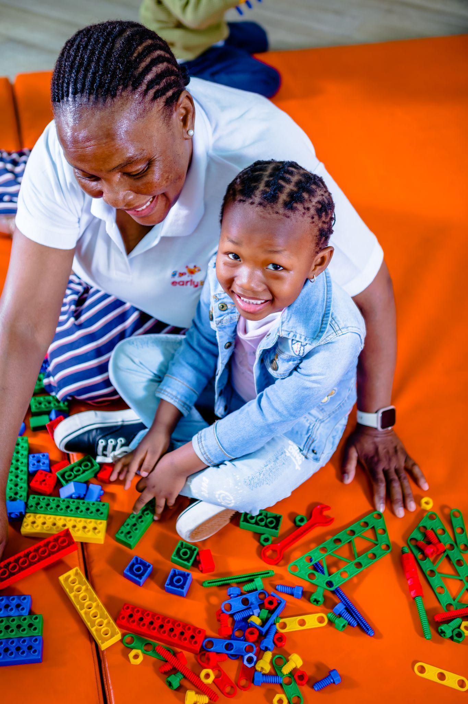
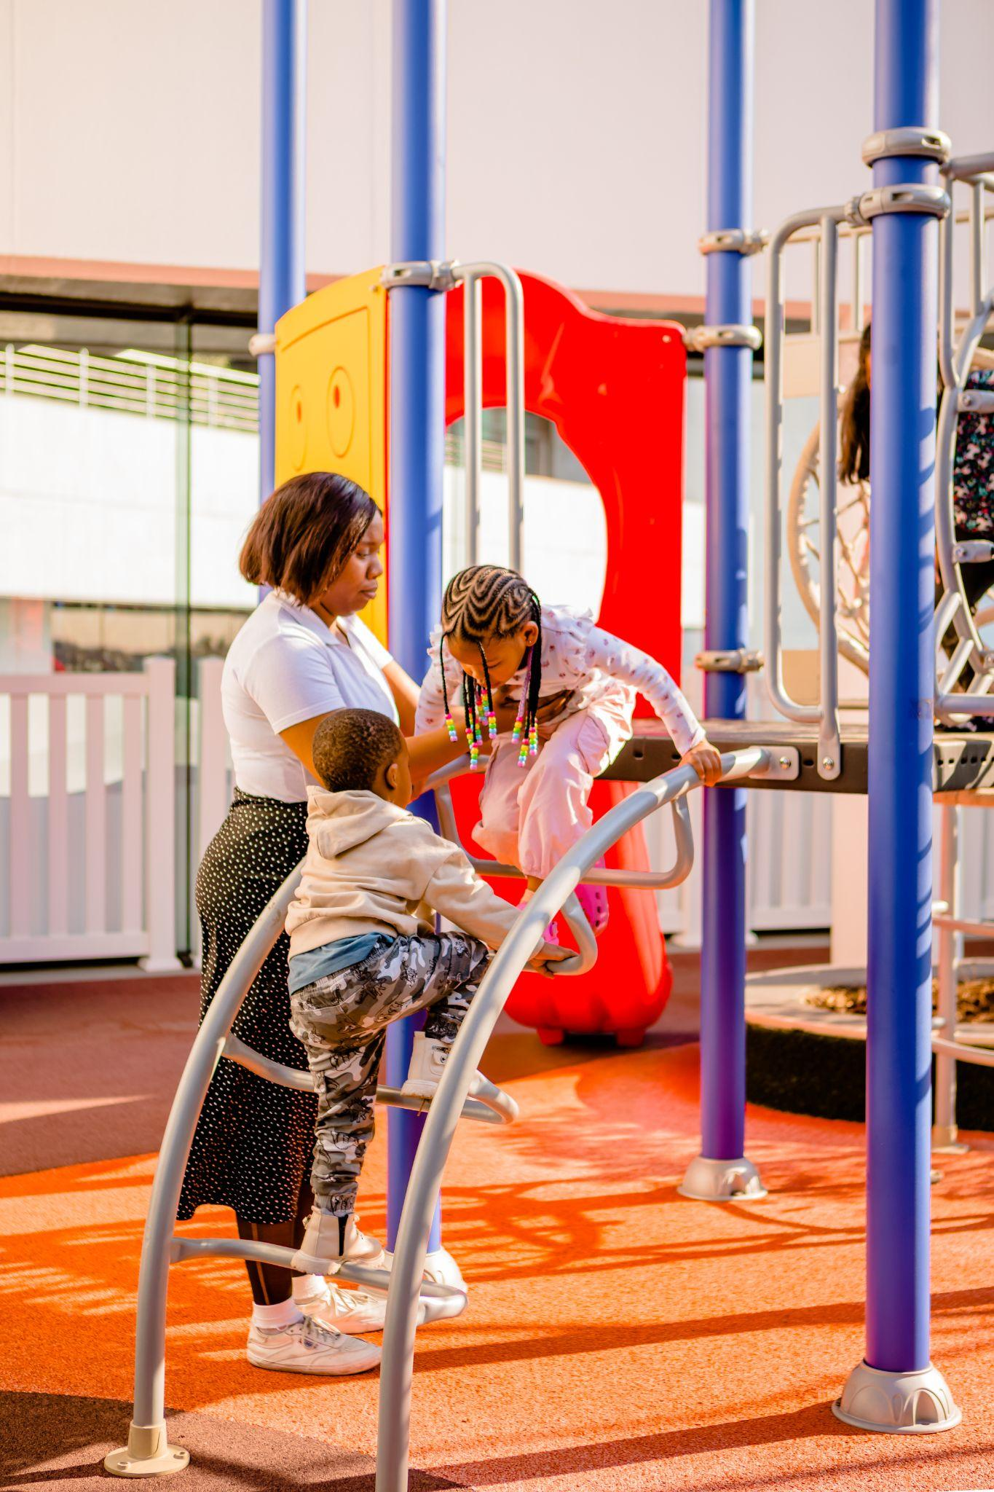

Contents
Fees and Enrolment Process
2026 Key Dates
Contact Details
Our Central Support Team
Our Teaching Team
What to pack
Communication and Contact details
Our Educational Programme
PeliCAN' (yet) process
Daily Routines: Operating Hours, Nap Times, Meals
Health and Safety @Earlybird
Sick Child Policy

Slide 4
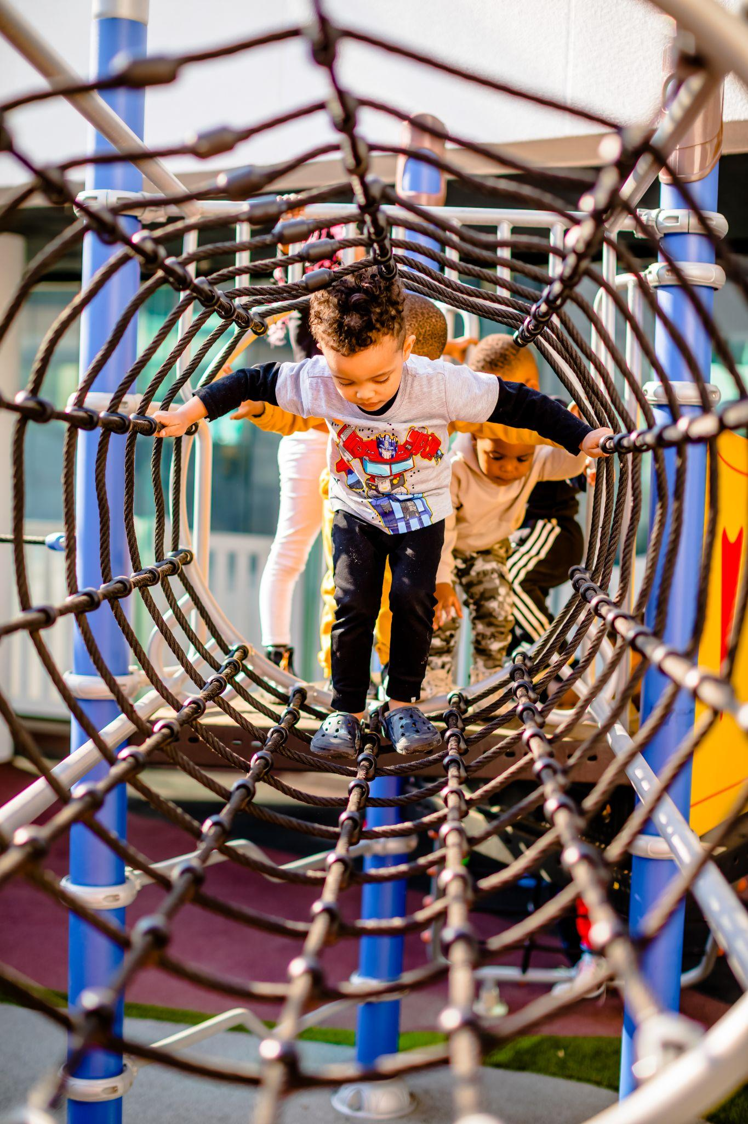
2026 Fees
Our fees are structured as follows:
Registration Fee - is once-off payment that includes one Earlybird t-shirt, a backpack, and a set of personal Earlybird bedding for use at nap time. After the first child in a family has registered, the subsequent siblings will not be required to pay the standard registration fee. The registration fee and the first month’s school fee must be paid in advance of the child’s first day starting at the educare centre.
Yearly Levy: this covers all stationary, cutlery, and educational resources your child will need for the year.
Monthly Fee – This covers our full-day educare offering (from 07:00 to 17:00), five days a week, including a nutritious breakfast and lunch meal prepared fresh in our on-site kitchen daily.
Fees are subject to annual increases in line with any increases in our cost of provision.
Up-front payment discounts are available at roughly -8% for annual and -4% for biannual lump-sum fee payments.
A half-day attendance option is available at 75% of the standard monthly fee. Half-day pick-up times vary by age group as follows: Blue Group: 12:00; Green Group: 12:15; Yellow Group: 12:30; Red Group: 12:45; Orange Group: 13:00.
Paused enrolment: families may pause enrolment for their child for up to a maximum of 3 months. A space-retainer fee of 75% of the standard monthly fee is required to hold the child’s spot open over the paused enrolment period.
One calendar month’s notice is required for dis-enrolment, and families who wish to re-enrol their child after a period of disenrollment will need to pay the registration fee again in order to re-enrol.

Slide 5
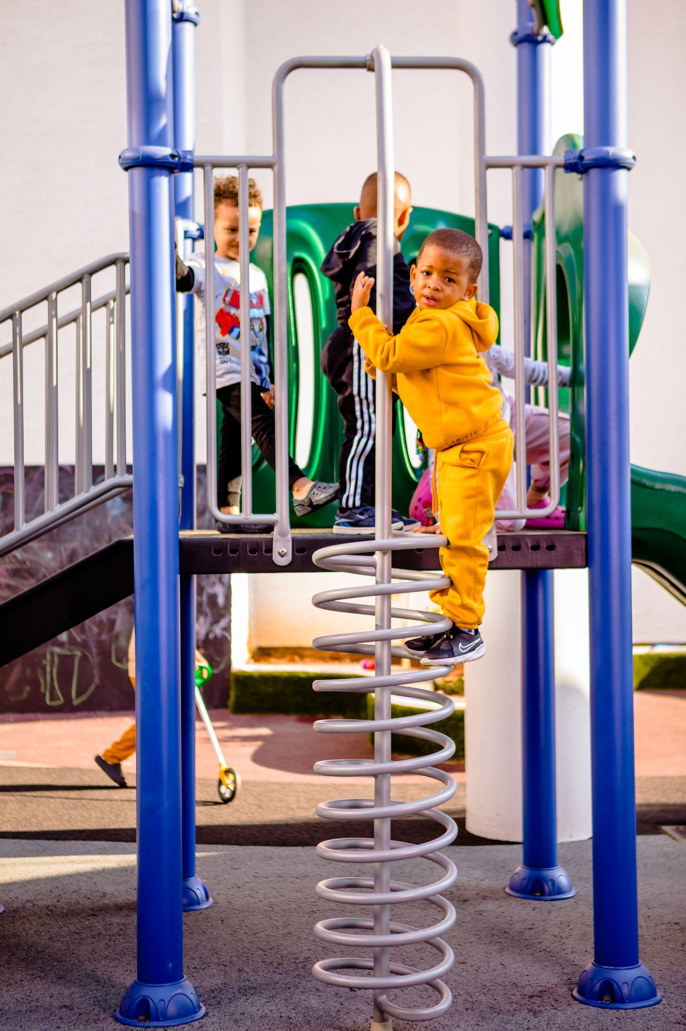
Earlybird’s Enrolment Process
STEP 1:
Book an appointment to talk to us using the “schedule a visit” button on our website.
STEP 2:
Complete our online enrolment form (you need to fill out and submit one full form for each child you wish to enrol). Doing so constitutes an ‘expression of interest’ and does not entail any kind of binding commitment on your part. Your Human Capital Business Partner will confirm your eligibility once your application has been received.
STEP 3:
You will be invited to schedule an appointment/tour: If you are satisfied after you have had a chance to talk with the centre’s principal and your child’s prospective teacher, you can sign our enrolment contract and upload the required documents for your child (birth certificate and clinic / vaccination card).
STEP 4:
Activate the debit order mandate for the monthly fee and settle the registration and first month’s fee invoices which you will receive via email (these payments can be made via EFT).
STEP 5:
Join the family WhatsApp group for your child’s class and find a time to talk to your child’s teacher or the centre principal about preparing your little one for their first day.
Please note that no child may start until all the required steps of enrolment have been completed.

Slide 6
Important Dates
12 January - 2 April Block 1: All about me
26 - 30 January “I can” Observational Assessment Week
2 - 6 February Parent Information and Introduction Evenings
30 March - 2 April Parent-Teacher Conferences
7 April – 26 June Block 2: My Home and Community
20 - 24 April “I can” Observational Assessment Week
15- 19 June Mid-Year Reports distributed
29 June - 25 September Block 3: Our Big Wide World
20 - 24 July “I can” Observational Assessment Week
28 September - 11 December Block 4: Animals and Their Homes
12 - 16 October “I can” Observational Assessment Week
7 - 11 December End of Year Reports distributed
Additional important dates and parent engagement events will be shared with you closer to the event, timeously, during the course of the year.
PLEASE NOTE:
Public holidays and closures in the year:
21 March: Human Rights Day (Saturday)
3 - 6 April: Easter weekend (Friday to Monday)
27 April: Freedom Day (Monday)
1 May: Workers’ Day (Monday)
16 June: Youth Day (Tuesday)
10 August: Women's day (Monday)
24 September: Heritage Day (Thursday)
Earlybird Educare Centres are intended to serve working parents, and as such, they are open throughout the year and do not close during standard school holidays. We only close on public holidays and over the December Builders’ Break. We kindly ask that you ensure your child attends school as regularly as possible.
This year, Earlybird Educare will close for the annual break at 17:00 on the afternoon of Friday, the 11th of December 2026, and will reopen on Monday the 11th of January 2027 (TBC)
Please look at our online calendar for more event information.

Slide 7
Contact details
.
The parent's first point of contact will most likely be the class teacher. It is the responsibility of the teacher to report all concerns and queries to the Principal. By reporting each incident, the Principal has more background knowledge should the incident need escalation. If a teacher is unable to handle a situation, the Principal will be involved in order for there to be a resolution as soon as possible. In cases where the Principal cannot handle the incident, Earlybird management must be informed in order for a resolution to be found.
In Centre:
  Principal Tablet: 060 659 0530
  Blue Group Tablet Number: 066 077 5283
  Green Group Tablet Number: 076 357 7154
  Yellow Group Tablet Number: 060 806 7288
  Red Group Tablet Number: 071 387 5865
  Orange Group 1 Tablet Number: 063 315 9191
  Orange Group 2 Tablet Number: 064 786 3672
Central Support:
  Bernice (Head of Education): bernice@earlybirdeducare.co.za
  Mpho (Head of HR and Operations) mpho@earlybirdeducare.co.za
  Hlaka (Customer Accounts Manager): hlaka@earlybirdeducare.co.za
After Hours Emergencies:
083 566 2047
We would like to gently remind you that the emergency contact number provided is a personal line. We kindly ask that it only be used in true emergencies - situations that require and involve an immediate and urgent response and cannot wait until business hours.
For all other communication, please direct your queries to the Principal during school operating hours, where they will be able to assist you.
For regular updates on happenings at our educare centres, follow us on Facebook: https://www.facebook.com/EarlybirdEducare/

Slide 8


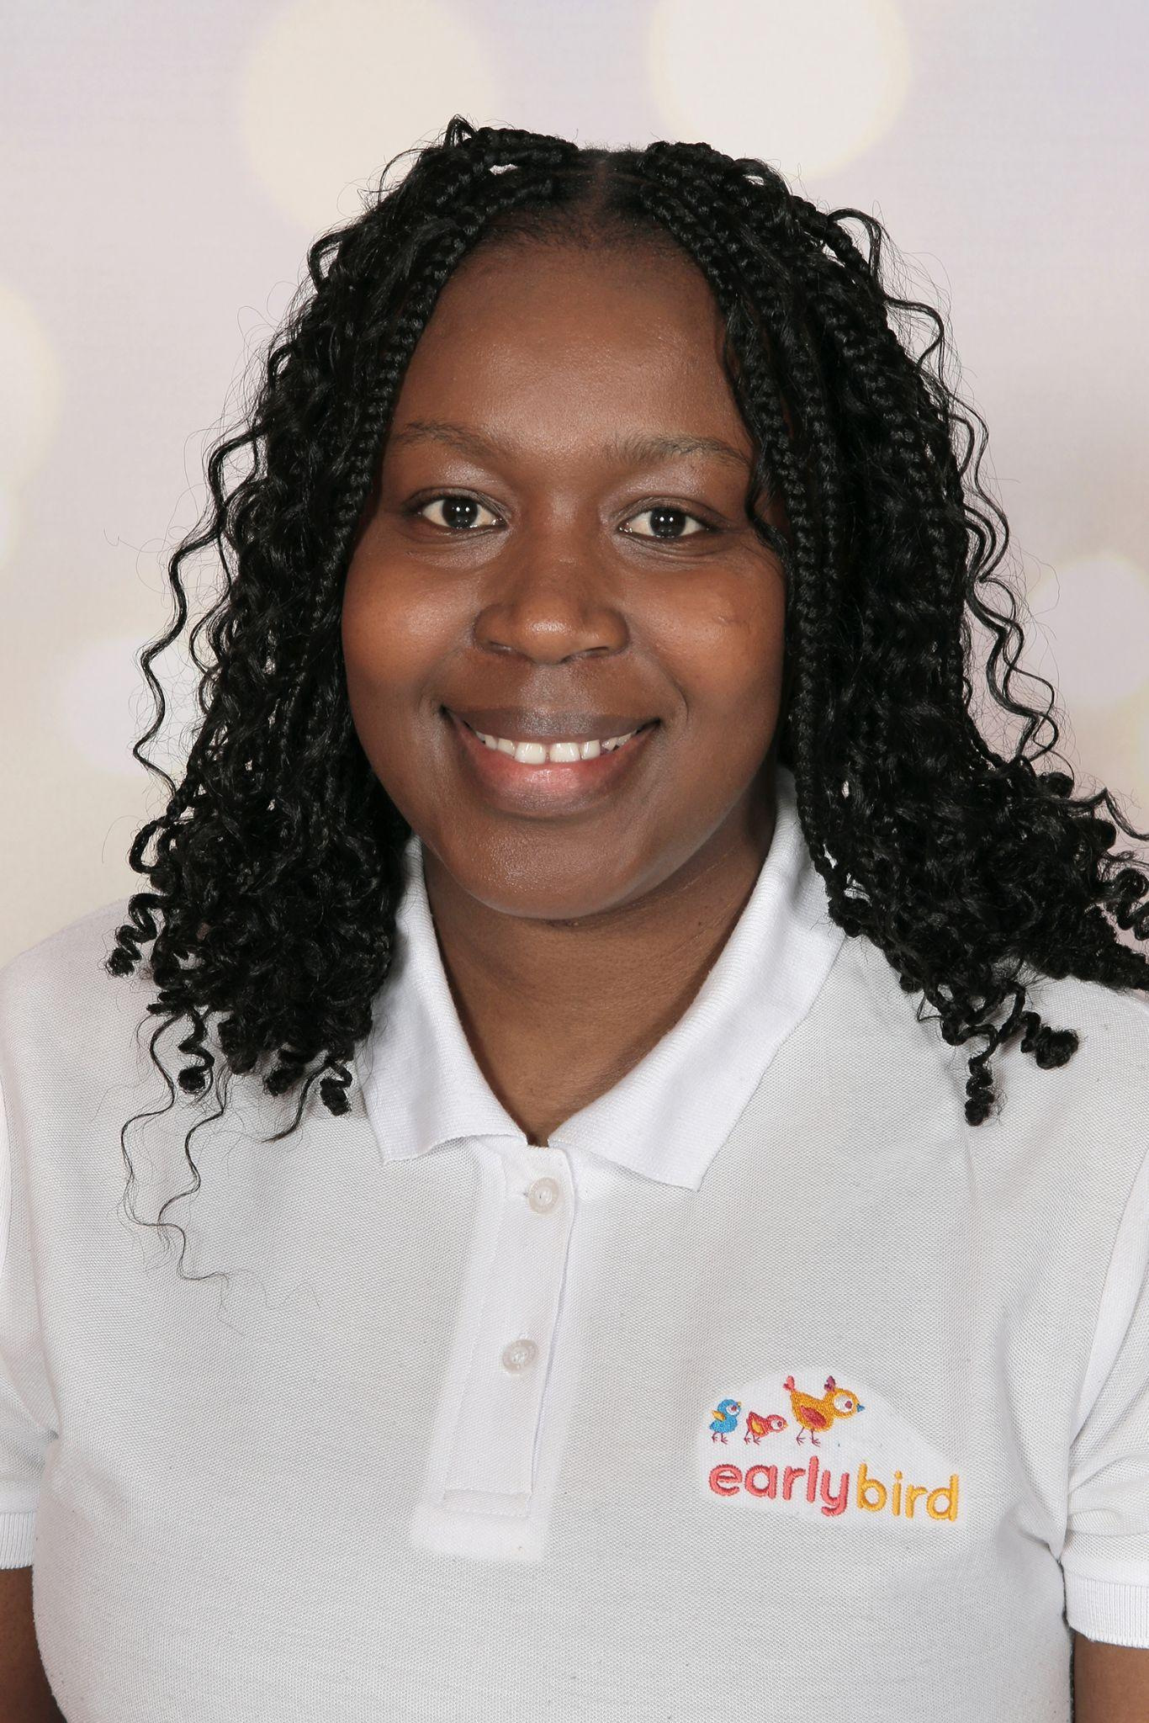
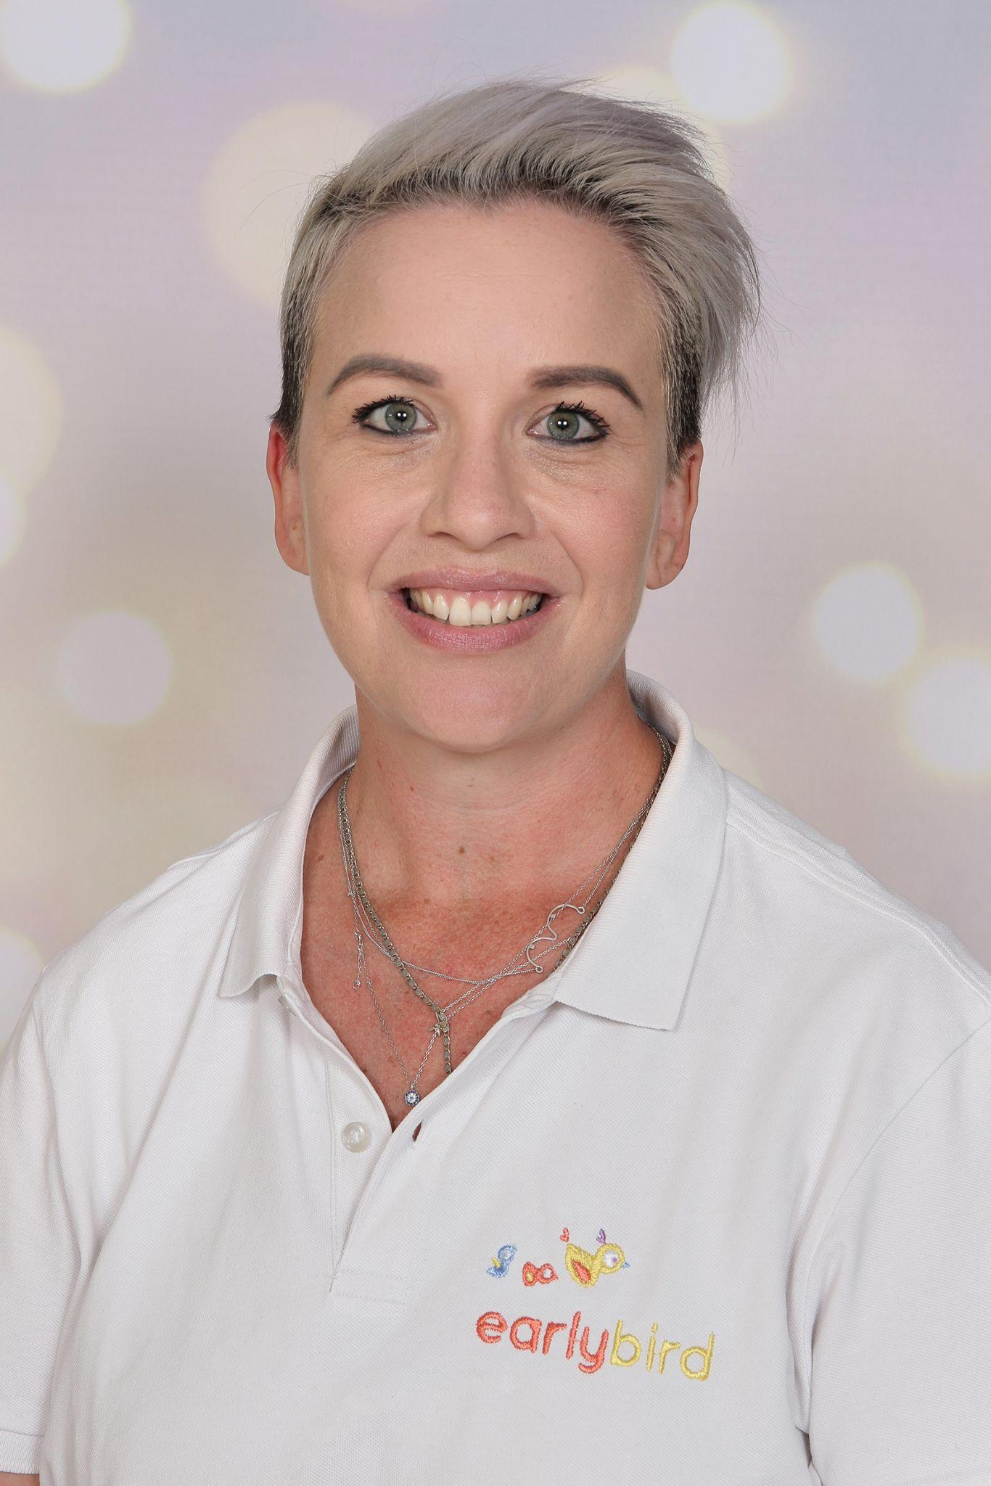
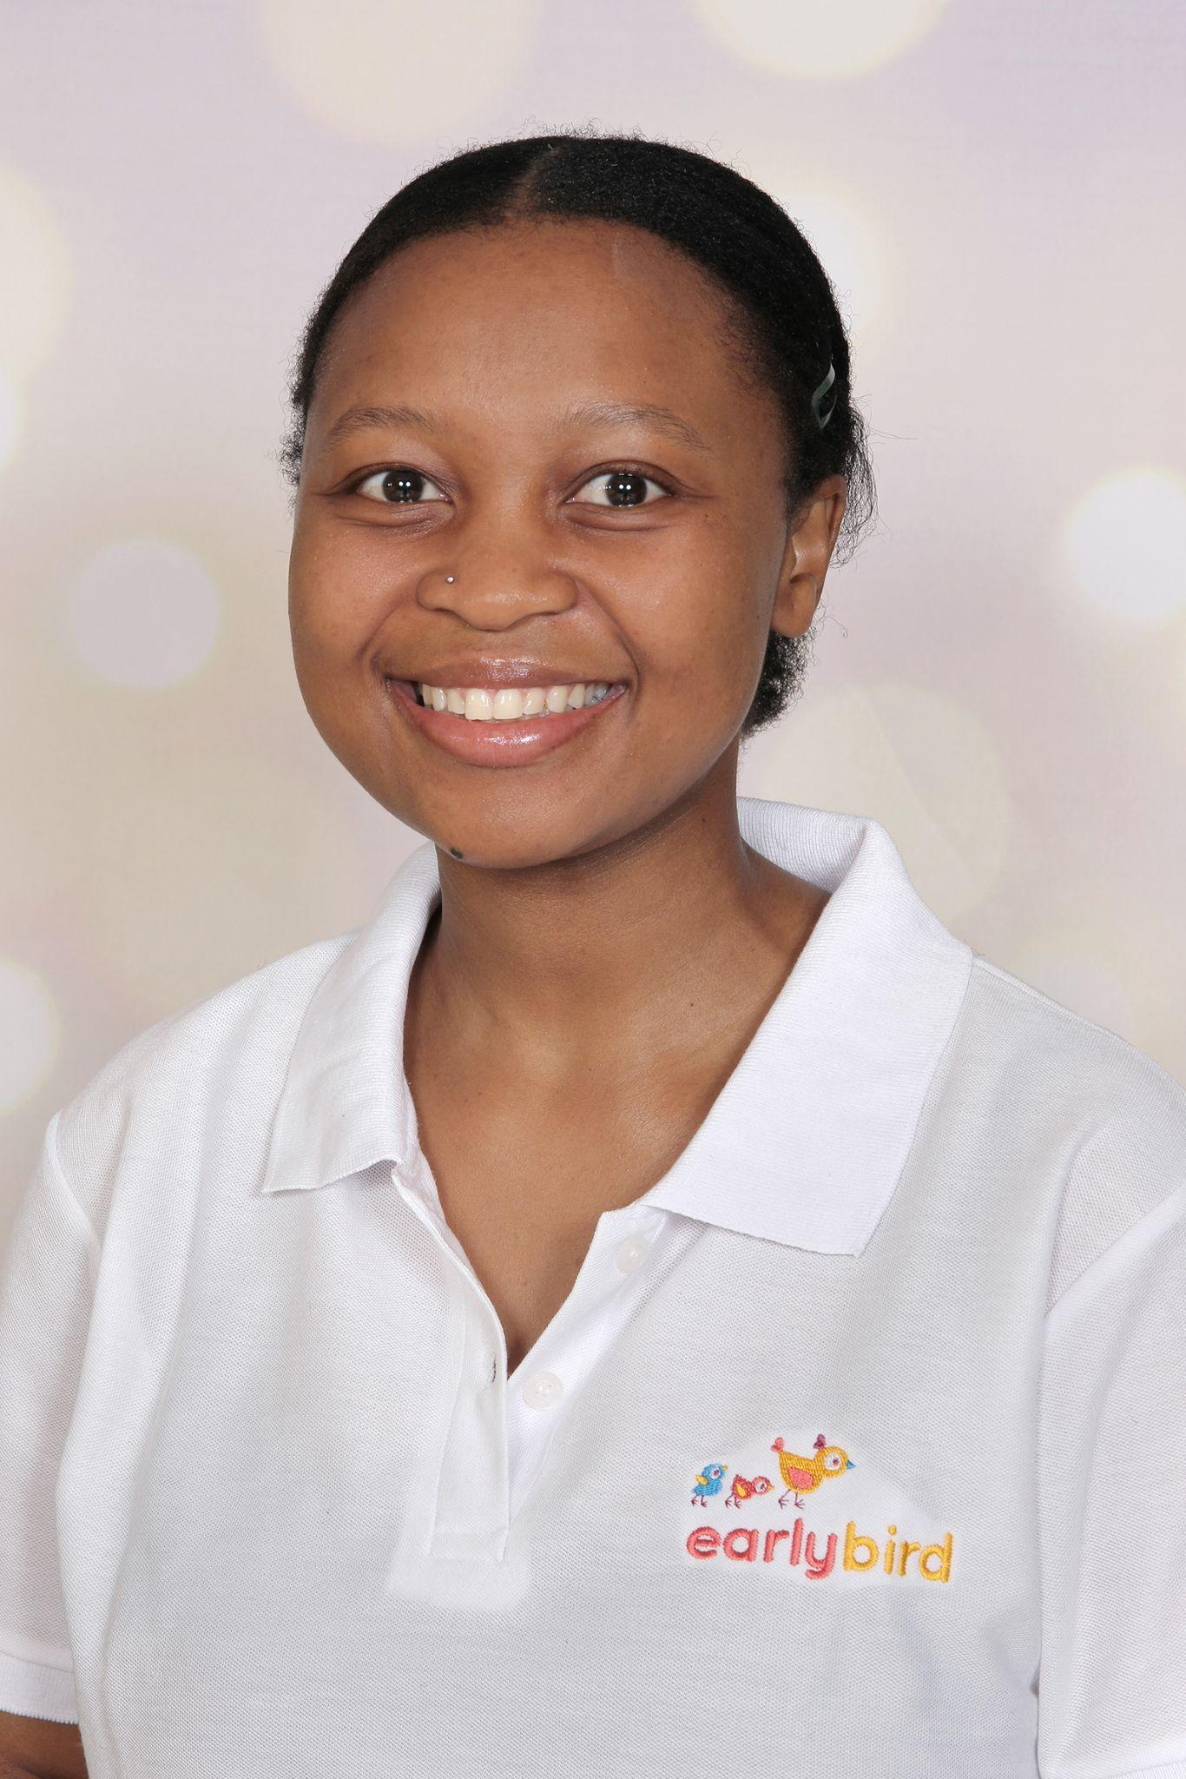
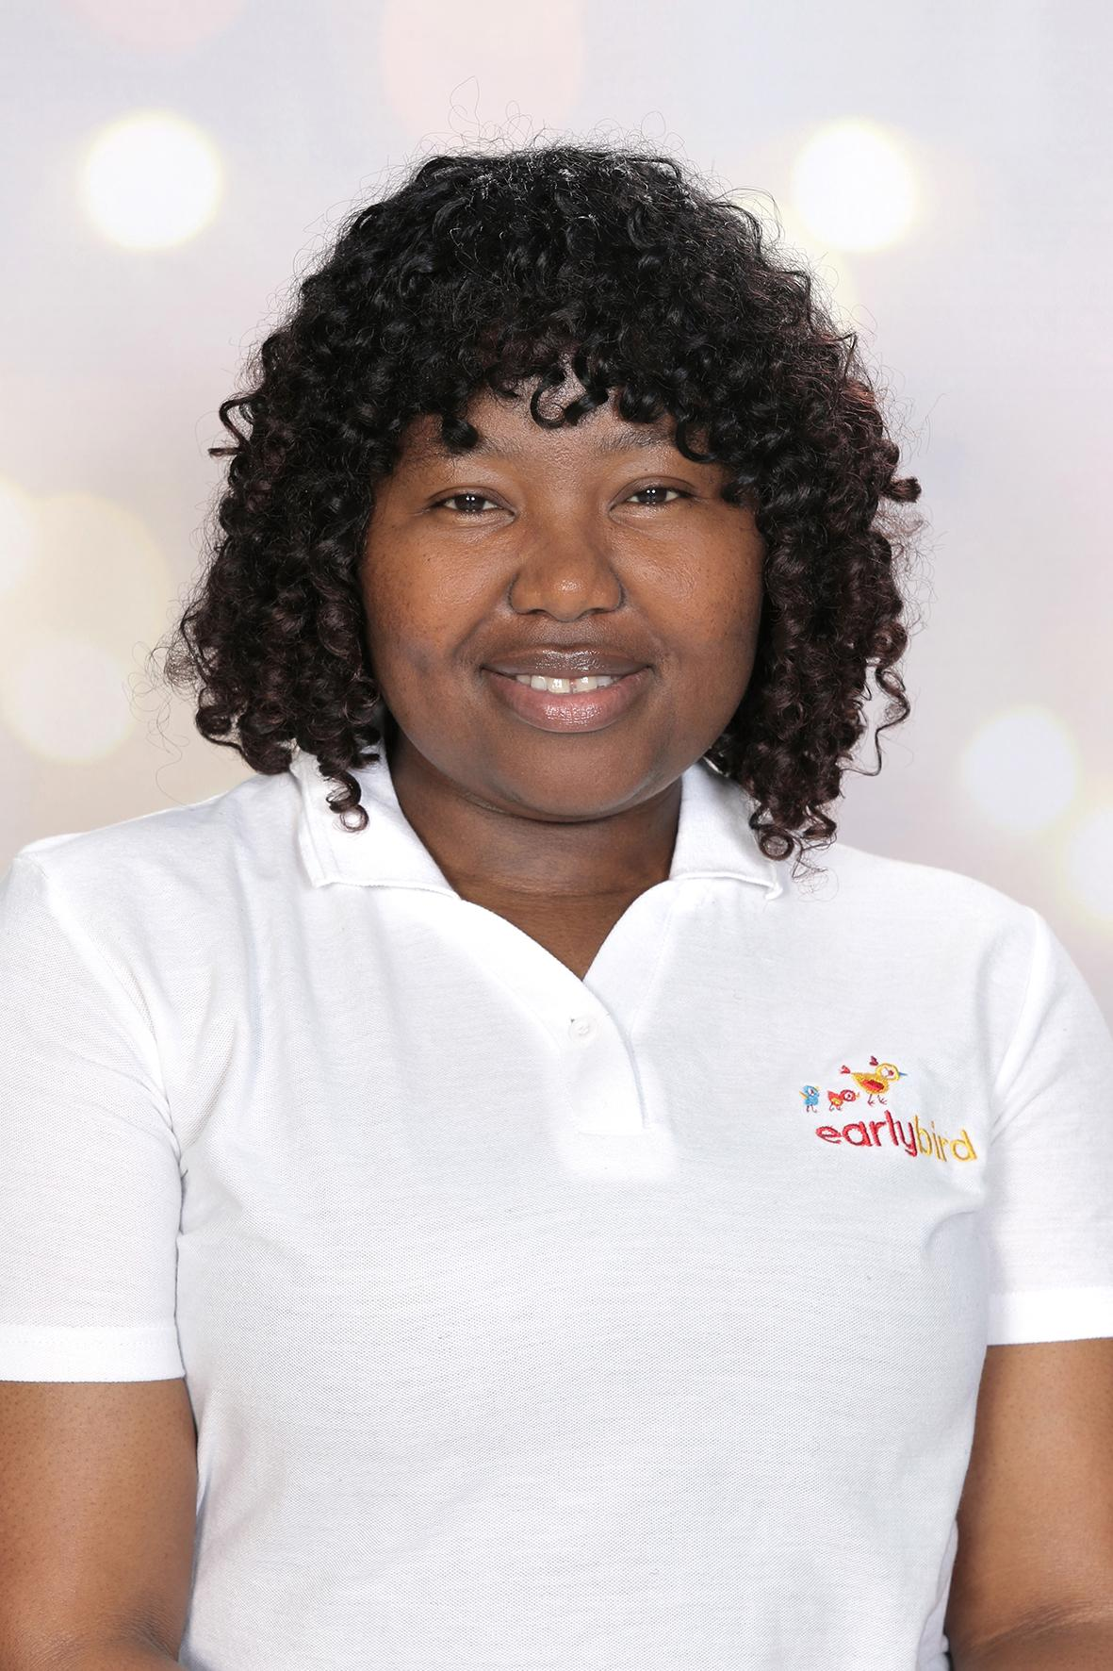
Our Central Support Team
Megan Blair
CEO
James Munnik
CFO
We’re here for you!
Mpho Mlanegni
Head of HR and Ops
Bernice McKee
Head of Education
Tshego Mokgobo
Finance Manager
Hlaka Zungu
Customer Accounts Manager

Slide 9
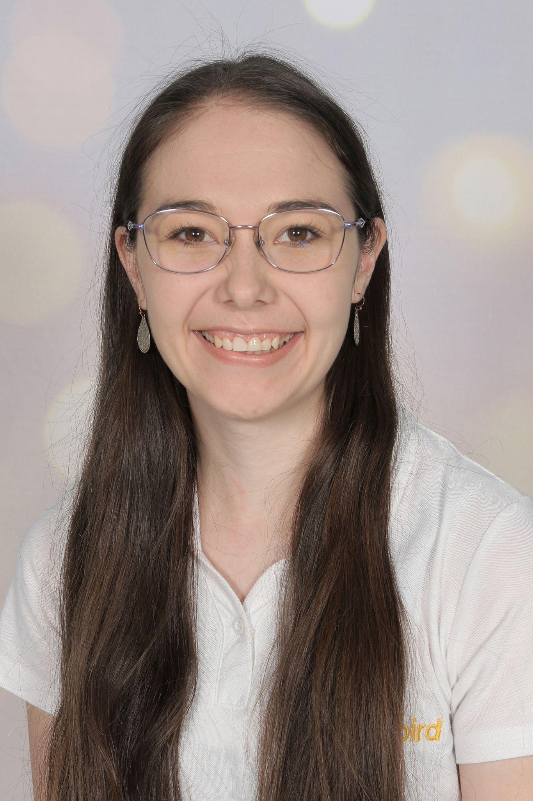
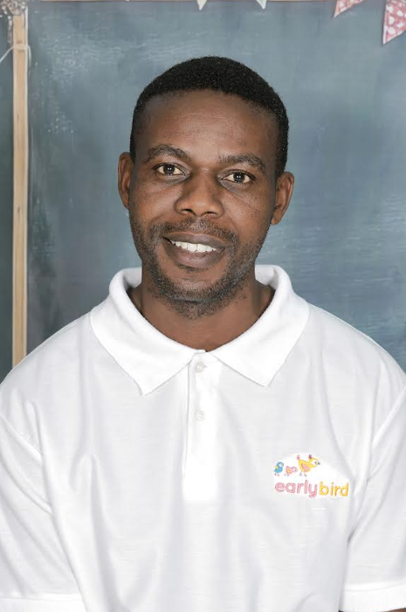
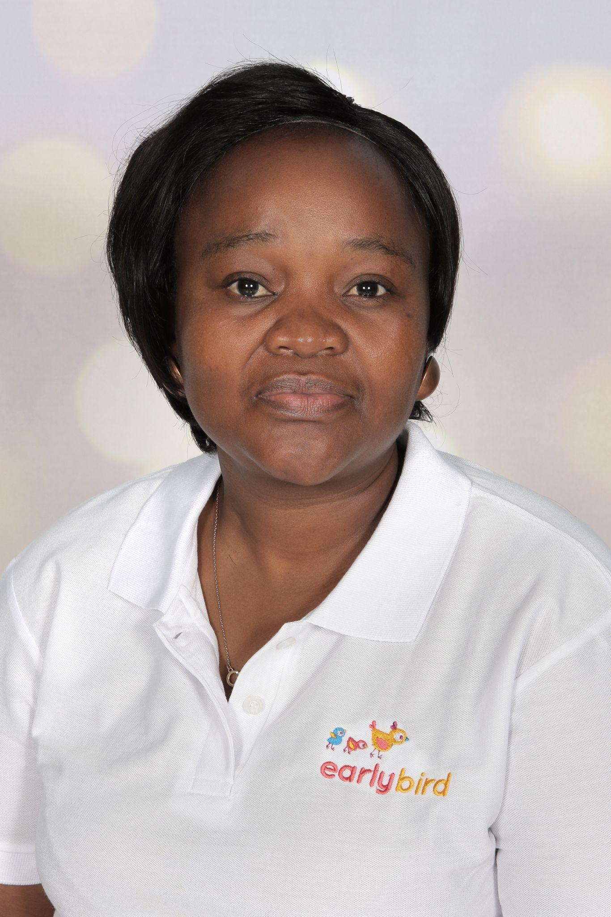

Centre staff
Meet the Team
Principal Sonika
Custodians
Teacher Amanda
Teacher Morgan
FMS
Teacher Thulani

Slide 10

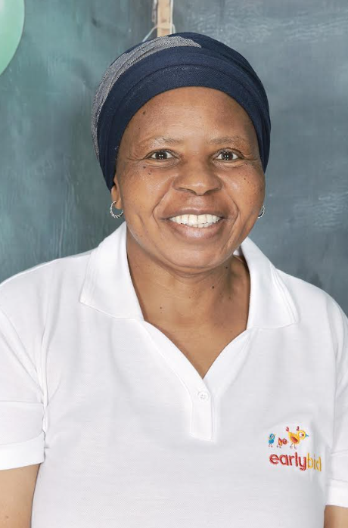
Blue Group
Lead Teacher
Teacher Karabo
Teaching Assistant Teacher Portia

Slide 11
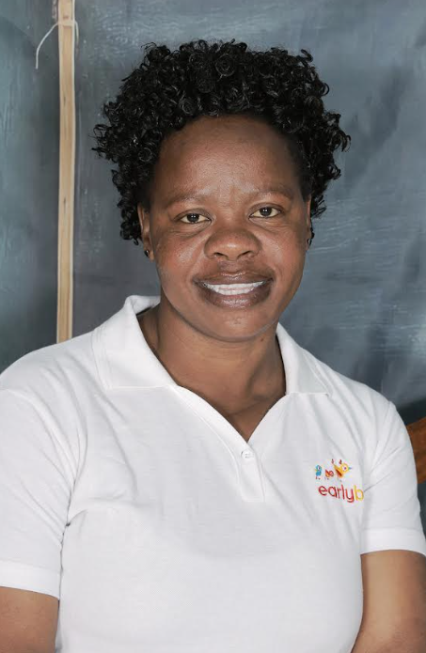
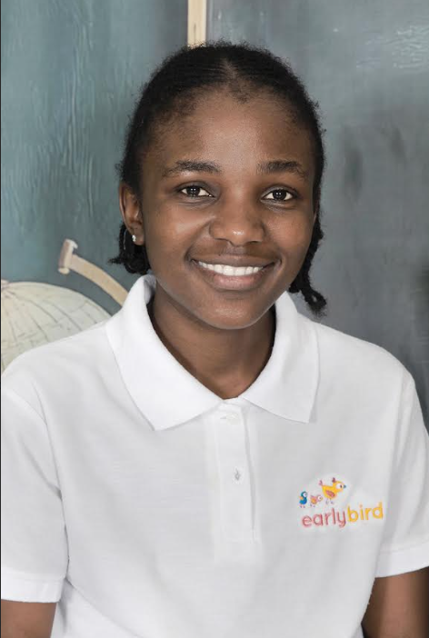

Green Group
Lead Teacher
Teacher Julia
Teaching Assistants
Teacher Lesiba Teacher Tsidi

Slide 12
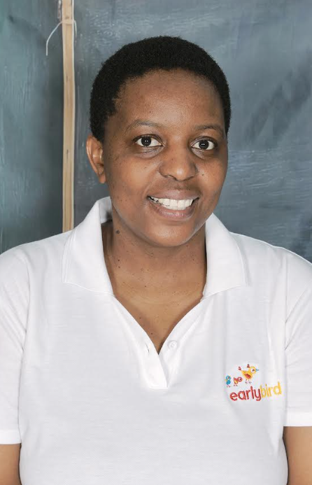
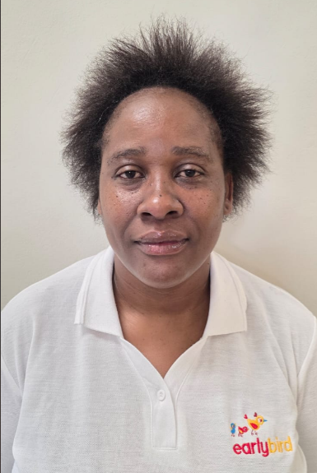
Yellow Group
Lead Teacher
Teacher Tshepo
Teaching Assistant Teacher Elizabeth

Slide 13


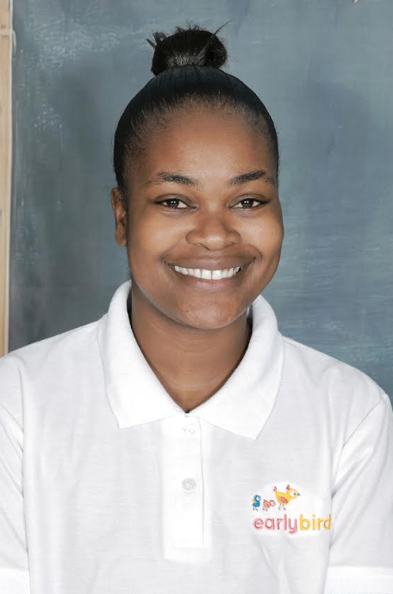
Red Group
Lead Teacher
Teacher Thobile
Teaching Assistants
Teacher Ayanda Teacher Sharlyne

Slide 14
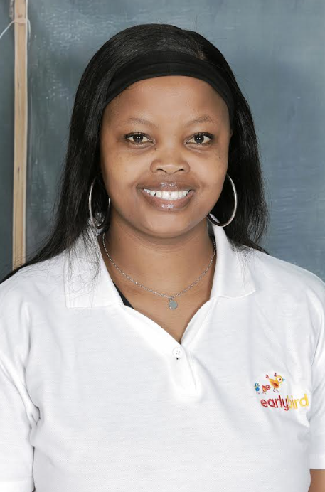
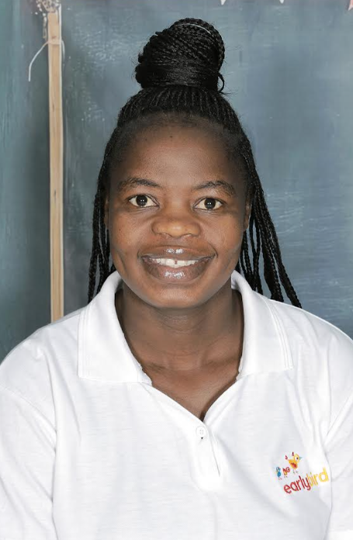
Orange Group 1
Lead Teacher
Teacher Tidi
Teaching Assistant Teacher Paris

Slide 15
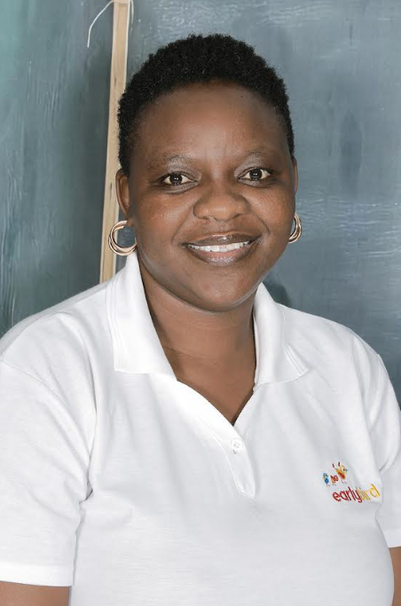
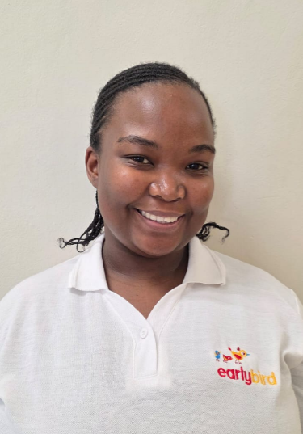
Orange Group 2
Lead Teacher
Teacher Tebogo
Teaching Assistant Teacher Lydia

Slide 16
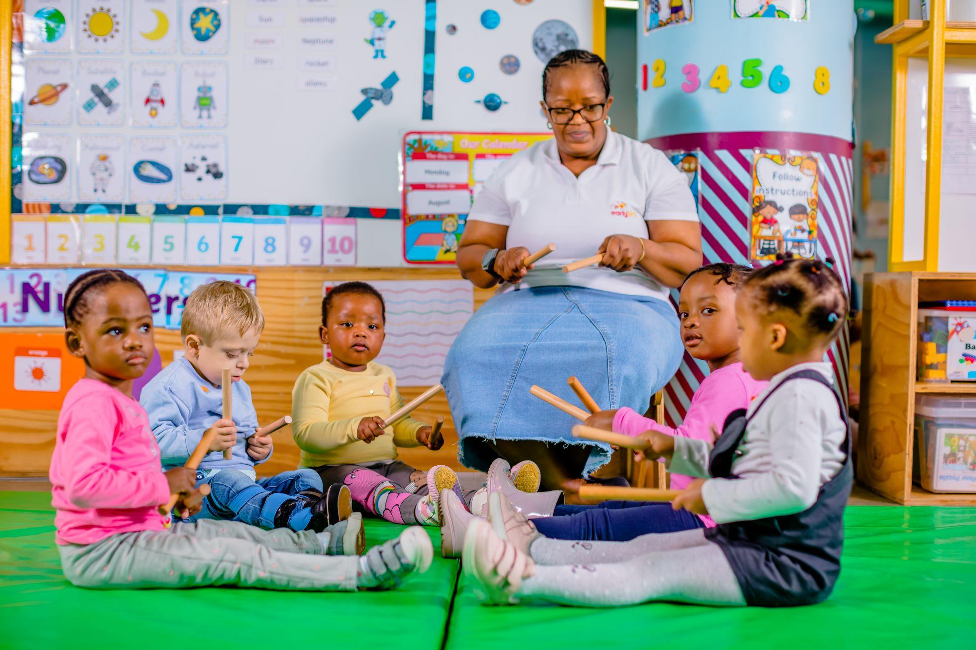
Teacher and Classroom Information
Class capacity
Blue Group: 12 Children
Green Group: 24 Children
Yellow Group: 24 Children
Red Group: 28 Children
Orange Group 1 and 2: 24 Children
Teacher/child ratios
Blue Group: 1 teacher per 4 children.
Green Group: 1 teacher per 8 children.
Yellow Group: 1 teacher per 12 children.
Red Group: 1 teacher per 12 children.
Orange Group 1 and 2: 1 teacher per 12 children.
Teacher leave
Teachers may take annual, study, maternity, or sick leave throughout the year. Substitute teachers are provided as needed.
Working shifts
Our Teaching staff work on rotating shifts. Each class has one teacher covering either the 7:00 AM to 4:00 PM shift or the 8:00 AM to 5:00 PM shift, depending on the rotation schedule.

Slide 17
Earlybird Menu
As part of our offering, children are supplied with two nutritious meals during the day - breakfast and lunch.
Our menus are designed to cater to the diverse needs of children throughout the year.
Seasonal Menus
We have both Winter and Summer menus, with a rotating lunch schedule that includes Week 1 and Week 2 options. This variety ensures that children enjoy a range of flavours and nutrients, keeping mealtime exciting and balanced.
Allergy and Food Aversion/Restrictions Friendly Options
Understanding the importance of catering to food allergies and food aversions or restrictions due to various reasons, we have developed winter and summer menus specifically designed to cater to all our children. Our thoughtful, inclusive approach ensures that all children can enjoy meals without compromising on taste or nutrition.
Pre-Solids Menu
For our youngest, we also provide a pre-solids menu tailored for babies who are ready to begin their journey with solid foods. This menu supports a smooth transition, offering gentle options that promote healthy eating habits from an early age.
We are committed to providing wholesome meals that support your child's growth and development.

Slide 18
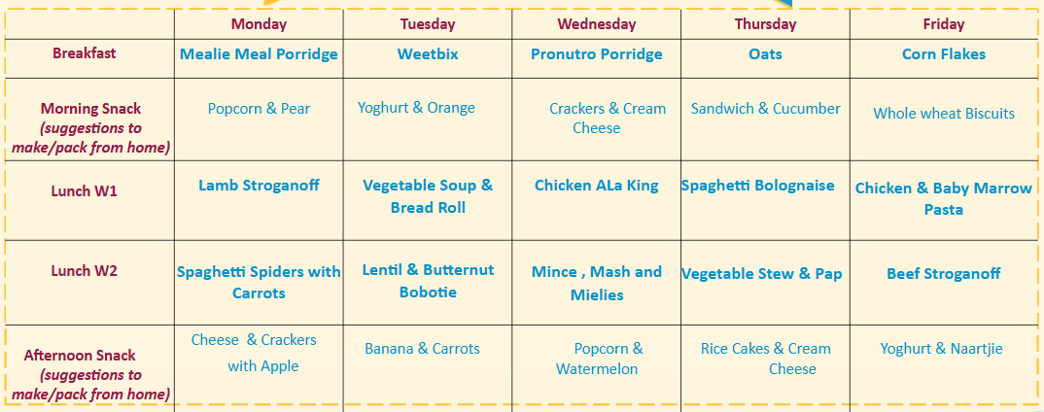
Winter Menu

Slide 19
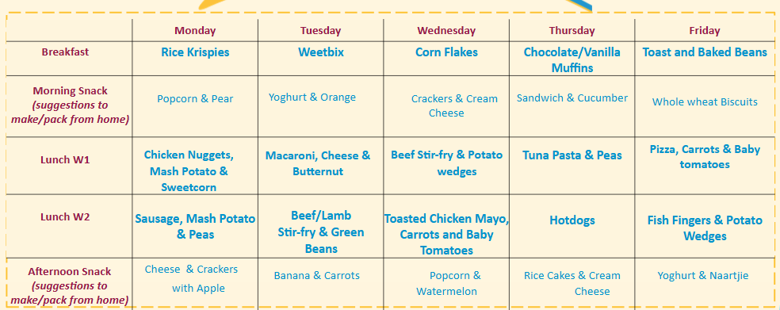
Summer Menu

Slide 20
What to pack
Please Label EVERYTHING!
Blue and Green Group
Yellow, Red and Orange Group
Enough nappies for the week (if your little one isn’t potty trained yet)
Preferred wet wipes and baby bum cream
2-3 extra sets of clothes
Sun hat
Sunscreen
Bottles with pre-measured formula (if needed)
2 healthy snacks (one morning and one afternoon)
Water bottle or sippy cup
Plastic packets for dirty clothes (nappy bags are ideal)
A painting shirt (An old oversized T-shirt)
A3 flip file for their beautiful art
Yellow Group
Enough nappies for the week (if your little one isn’t potty trained yet)
Preferred wet wipes and baby bum cream
Yellow, Red and Orange Group
2-3 extra sets of clothes and underwear
Sun hat
Sunscreen
2 healthy snacks (one morning and one afternoon)
Water bottle or sippy cup
Plastic packets for dirty clothes (nappy bags are ideal)
A painting shirt (An old oversized T-shirt)
A3 flip file for their beautiful art
Notes:
Extra clothes are important, Accidents happen.

Slide 21
Parent Communication
Strong relationships require effective communication. A positive, trusting collaboration that benefits your child requires open, respectful communication between home and the centre. It prevents misunderstandings, fosters respect, and clarifies expectations. This eases the transition between home and care, gives your child confidence and belonging, and teaches them respect.
Communication channels at our centre:
Face-to- face communication (Open door policy)
  The teachers are available for daily verbal interactions in the morning during drop off or in the afternoon during collection.
Blue Group Communication Books
  Parents provide evening updates, and teachers will share details about the child’s day. This exchange is critical for monitoring developments and needs. This plays a vital role in tracking a child's mood, health, and daily interactions.
WhatsApp Class Group (Broadcast Only)
  Used for activity updates and photo collages.
  Unit Introduction Message: Sent every two weeks to outline the unit, key concepts, and vocabulary introduced to your child.
  Important reminders.
  Please note and respect others privacy when sharing photos on social media (other children in the background). Refer to your enrolment contract for more.
Teachers are only available to communicate on their tablets from 12:00 PM to 2:00 PM during nap time. For urgent matters, please contact the principal.
Tablets are not taken home; kindly avoid messaging outside of work hours. (Centre Hours)
The Central Line is available after hours for EMERGENCIES ONLY.

Slide 22
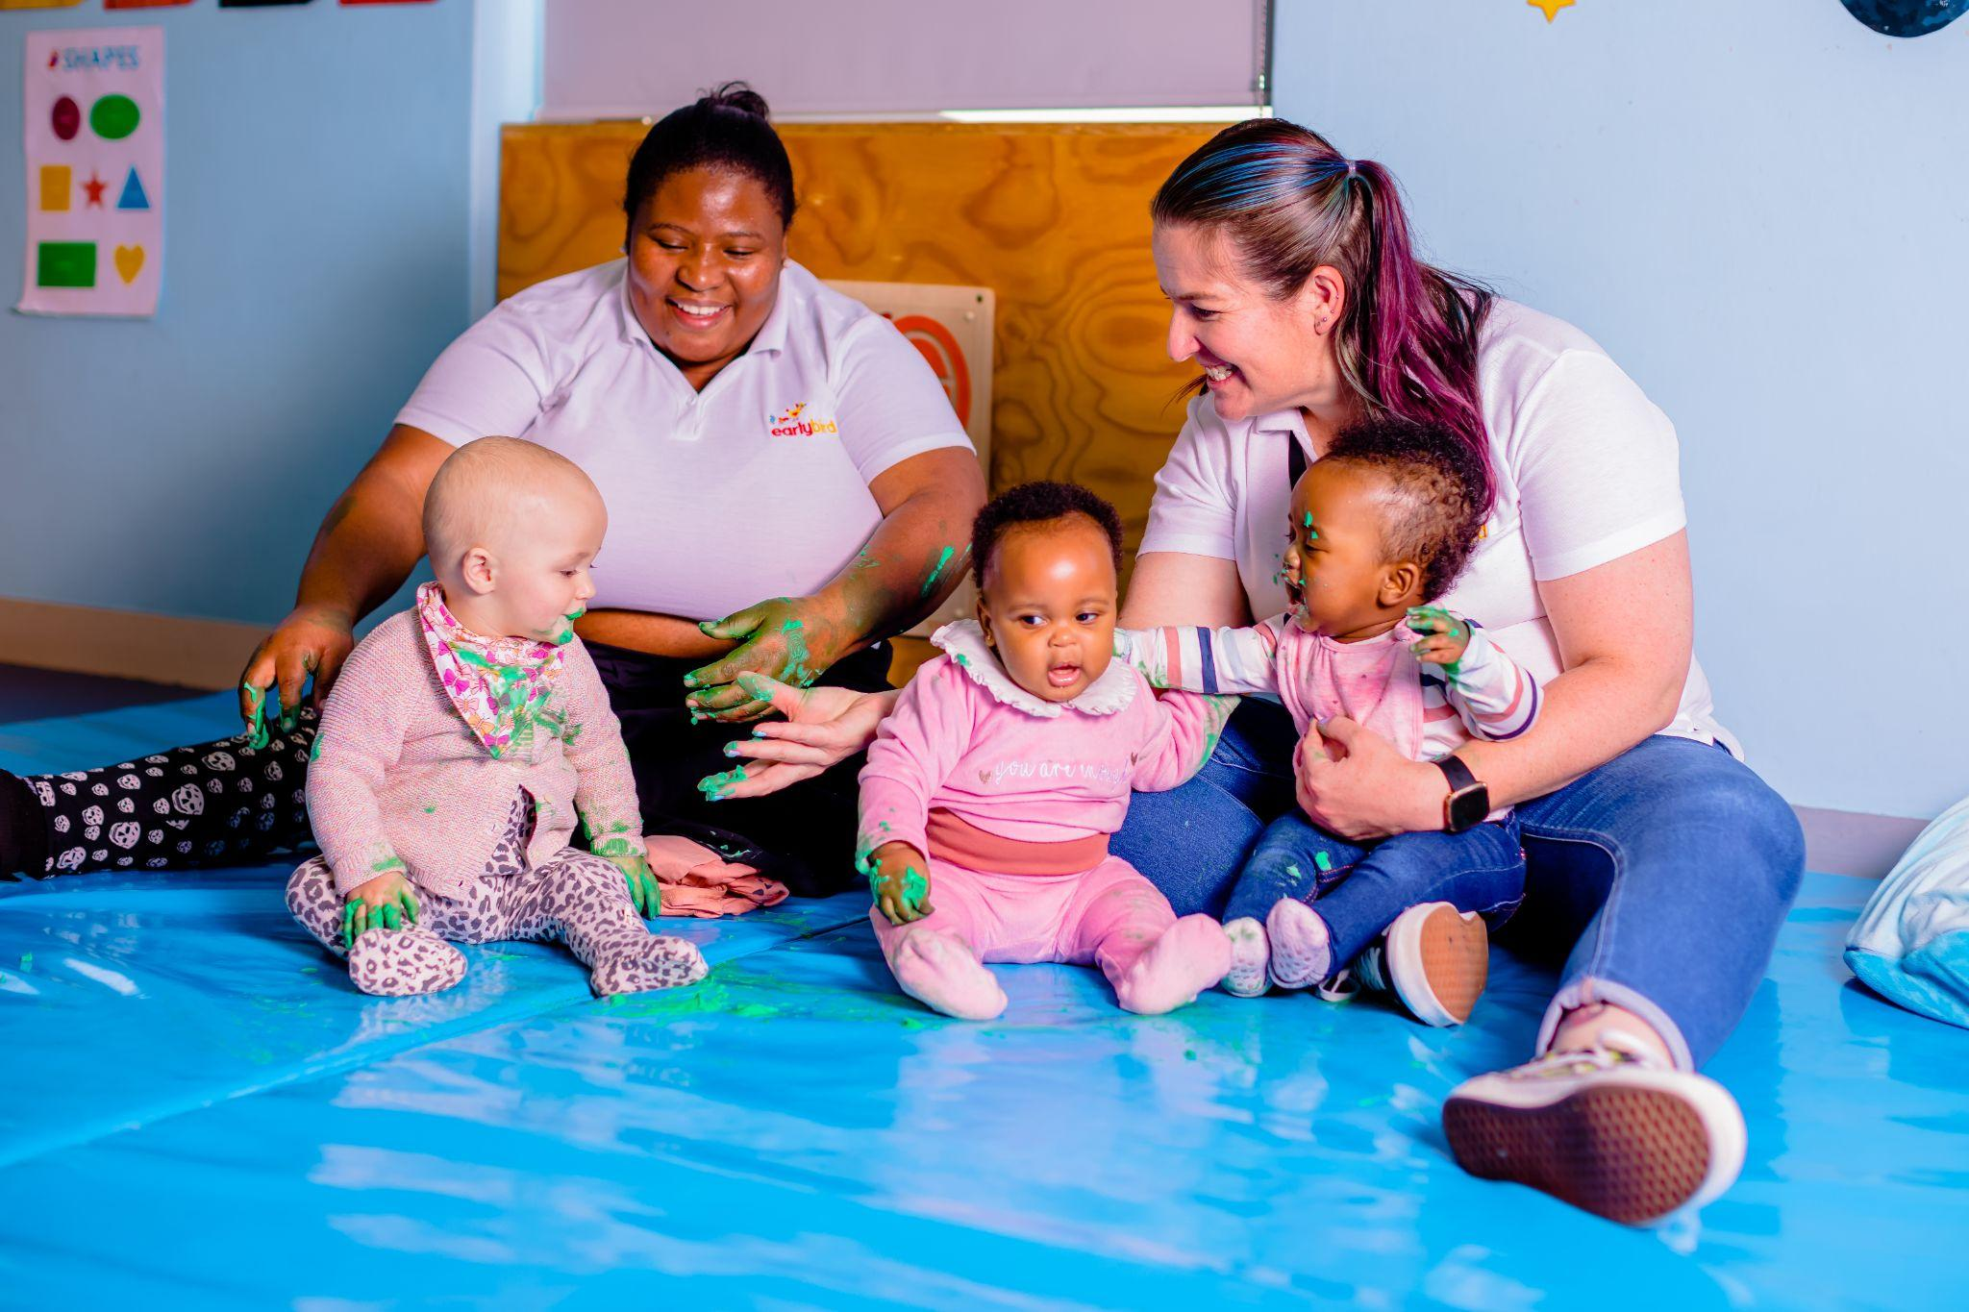
Our learning approach
Child-Centred Learning
We begin with the child, focusing on where they belong, and gradually expand to explore the world around them.
Fundamentals
Our main focus areas include:
  Shapes
  Numbers
  Colours
  Sounds
Activity Design: Scaffolding & Extension
Every activity is thoughtfully designed with two components:
  Scaffolding: supporting the development of specific skills, concepts, or knowledge.
  Extension: deepening and refining skills or concepts for further learning.
Daily Activities
On average, we complete 3 activities per day plus class discussions.
Morning rings (class discussions) are a vital part of our routine, while reinforcement at home helps consolidate learning.
Group Focus Areas
  Blue & Green Groups: Creative Sensory & Movement Activities.
  Yellow, Red, & Orange Groups: STEAM (Science, Technology, Engineering, Art, Mathematics) alongside Creative Expression, Drama, Movement, and Music.
Sustainability in Action
We prioritise recycling in our activities, using materials such as egg cartons, yoghurt tubs, ice cream tubs, boxes, lids, tins, bottles, and newspapers.

Slide 23
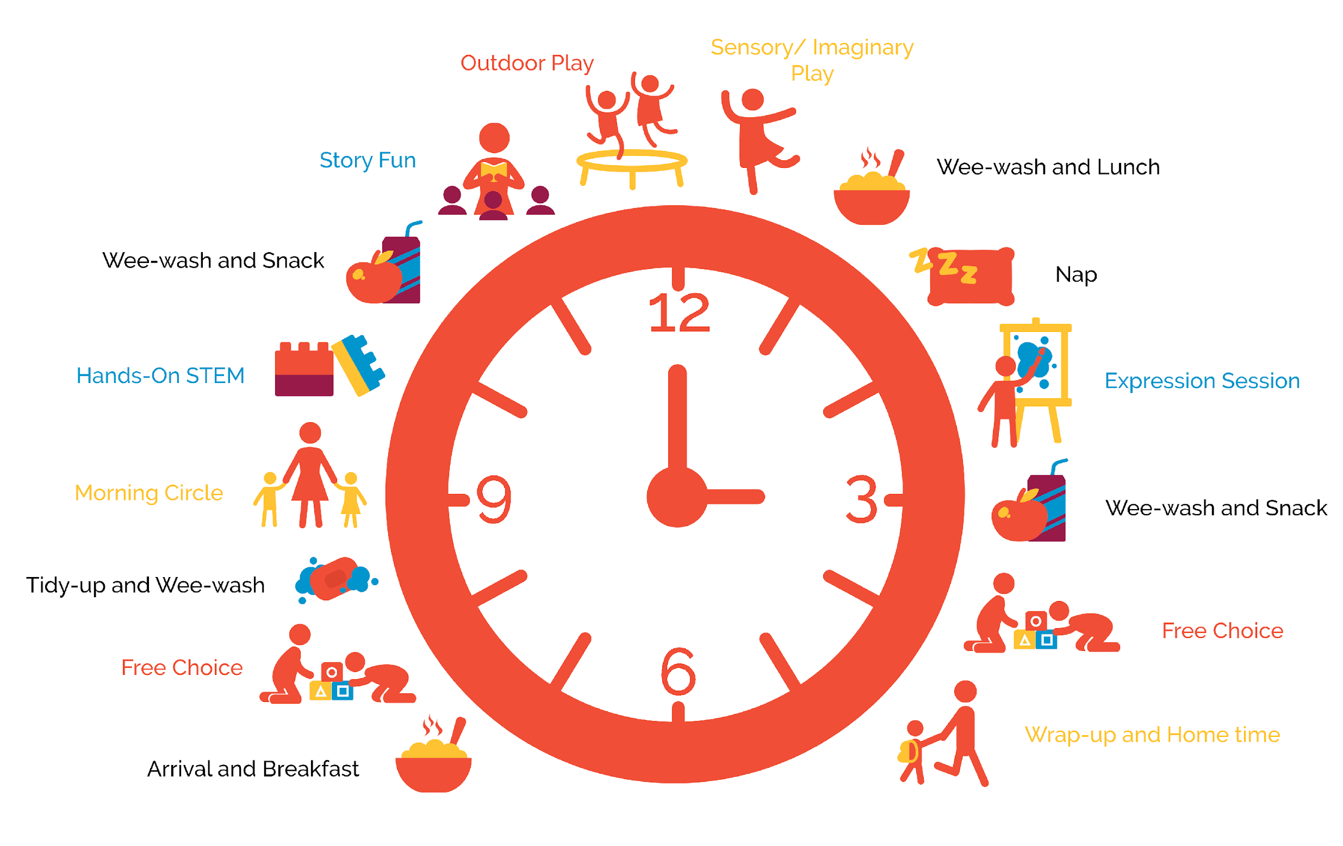
Daily Routines
Unstructured learning experiences each day:
  Free Choice the “Plan, Do, Review” technique is used to build children’s autonomy and executive functions during this play-based learning period in the day.
  Outdoor Play is a time for gross motor development, exploration and boisterous, messy fun.
Semi-structured learning experiences each day:
  Morning Circle provides a time for social-emotional check-in.
  Sensory / Imaginary Play is an opportunity for fantasy and role play, drama games, open-ended scenarios.
  Wrap-up and Home Time is a window for reﬂection on today’s events and preparation for tomorrow.
Structured learning experiences each day:
  Story Fun is our main vehicle for language and emergent literacy development.
  Hands-on STEM is an opportunity to encourage curiosity, building, reasoning and foundational mathematical skills through carefully designed activities and games.
  Expression Session is all about creativity and getting kids to express themselves in lots of diﬀerent ways.
Earlybird@Carlswald will operate from 7 a.m. to 5:00 p.m.
Our daily routine varies by age group, but the graphic below gives you a sense of the general ﬂow of each day:

Slide 24
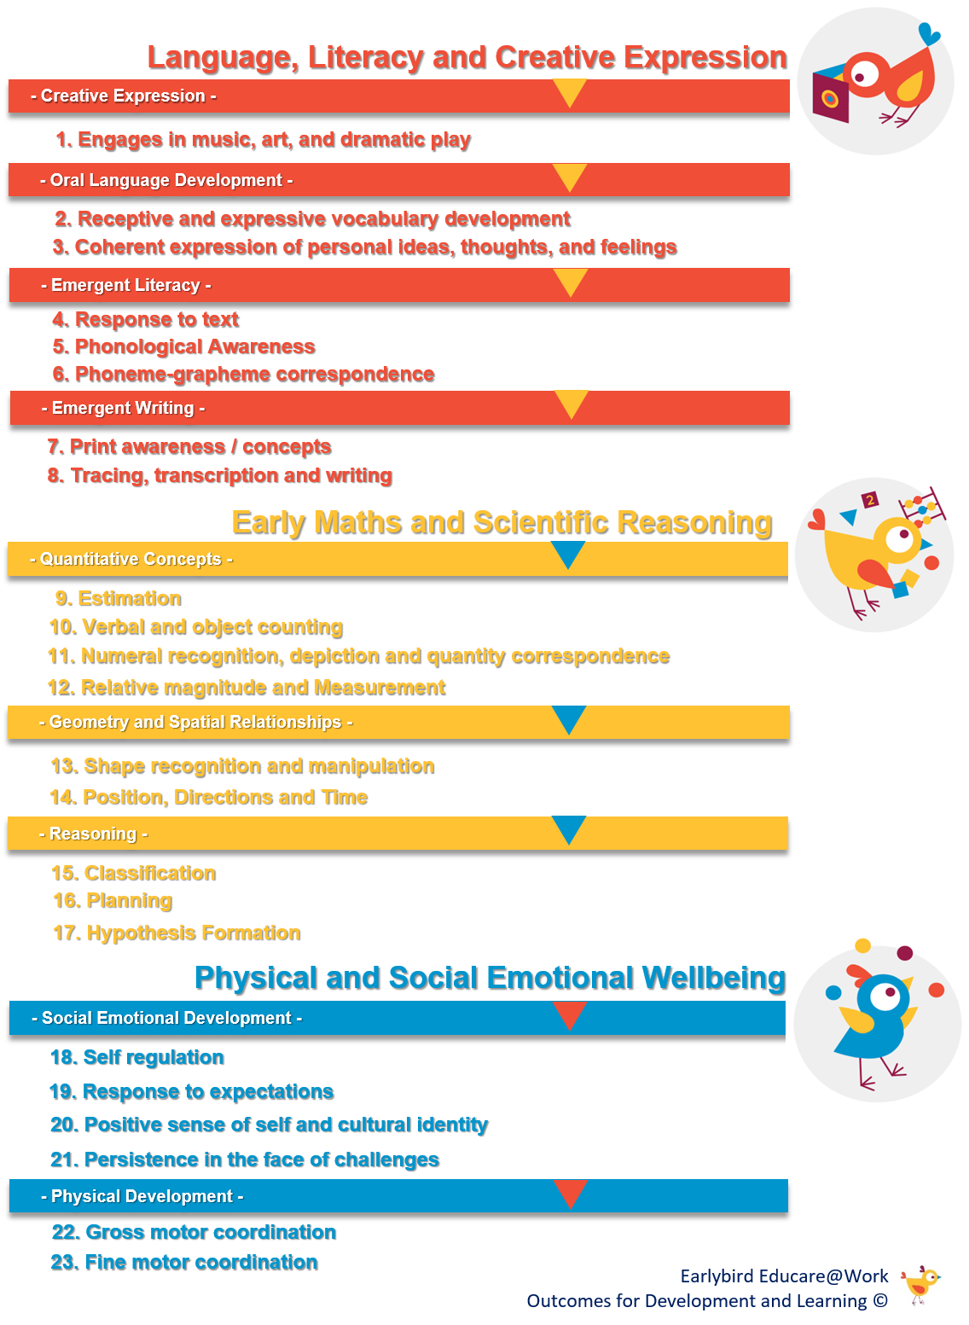
Our Educational Programme
Getting ready for ‘big school’
Our curriculum is underpinned by 23 Objectives for Development and Learning (ODLs) which are mapped to the National Curriculum Framework (NCF). All of our 23 ODLs have been demonstrated by research as foundational to children’s successful transition to and functioning in primary school and beyond.
Each ODL has been broken down into a series of ‘steps’ that a child is expected to progress through on their way to mastering that particular objective. All activities and games on our teaching guide, Bird Seed, which take place during the three structured learning periods in the day (Hands-on STEM, Expression Session, and Story Fun), are mapped to a particular learning and development ‘step.’
We conduct regular observational assessments to track children’s development and learning and keep open lines of communication with families regarding each child's progress and achievements. We are available to discuss your child's individual needs at any stage.
Read more at:
https://earlybirdeducare.co.za/learning-programmes/

Slide 25
“I can”, PBL, ODLs and Reports
Observations
We use an ongoing formative assessment to meet each child where they are at. This means that our teachers continuously observe and update their records.
We do not evaluate a child's ability based on a single situation or activity.
We set aside time every three months to collect targeted observations during our "I can" week in order to provide feedback and reports.
“I can” weeks
We assemble information into a student/child portfolio of proof that showcases your child's skills in painting, colouring, drawing, matching, identifying shapes and colours, and cutting, to name a few.
These are critical weeks; otherwise, your child will miss out on the skill revision.
This takes place four times per year.
ODLs
We have 23 Outcomes for Development and Learning.
These map the developmental milestones of your children in our care.
Reports
Twice per year (June/July and November/December)
Teacher feedback
Parent Teacher meetings occur
PBL
Project Based Learning
The value of PBL is that it builds children’s creative capacity to collaboratively work through problems and projects.
Notes:
Ongoing observation
I can Weeks - 4 per year, benchmark
23 ODLS that we work with - this is the milestones in which we follow for our observations.
Reports twice a year and one on one feedback twice a year.
Fundamentals
Scaffolding and extension

Slide 26

Earlybird’s PeliCAN’T (yet) Process
Our Pelican’t (yet) process is an educational support program that assists our young learners that need a little more time or encouragement in meeting their developmental milestones.
A PeliCAN’T (yet) is a developmental milestone (or milestones) that a child has not mastered YET. We use these PeliCAN’T (yet) statements to describe a concerning, unusual, or uncommon recurring set or series of behaviours that we, as teachers, will need to identify and observe in order to implement support, as we aim to create an Inclusive Education environment.
These PeliCAN’T (yet) statements are a guideline of behaviour, skills, and developmental milestones that we feel children should have developed by a certain age. These milestones are at the late end of the scale and are not set in stone, as we recognise all children have a unique pace in which they meet their milestones. We understand that some children take longer to do so or might need more support than their classmates.
Our responsibility as teachers is to ensure we are aware of the unique needs of our little ones and to meet them where they are in order for them to fulfil their full potential while in our care.
We do this through biweekly, targeted classroom observations, regular check-in meetings with Central Support and parents, purposeful classroom and at-home interventions, and, when needed, the use of specialised therapists.
Notes:
This starts with a two week observation when we have any concerns, parents will be informed and we will start the process of extra support in centre and home then possible reach out for assessment and therapies if needed.
We want to help and provide as much possible support as we can and we do expect parents to also do their part.

Slide 27
Morning Ring: The foundation of our day
How Morning Ring Benefits Children:
Routine & Predictability
  Establishes a consistent routine, offering security and predictability, which supports emotional well-being.
Community Building
  Encourages interaction with peers, fostering a sense of belonging and developing social skills.
Language Development
  Songs, rhymes, and discussions promote vocabulary growth, communication, and listening skills.
Introduction to Concepts
  Engages children in fun and interactive ways to introduce educational concepts through calendar time and group activities.
Smooth Transition
  Helps ease the transition from home to school, setting a positive tone for the day.
Please arrive by 8:30 AM
Morning Ring is our gathering time, where we focus on:
Greetings
Calendar Time
Sharing news and thoughts
Introduction to the Unit
Group activities, new songs and rhymes

Slide 28

The Importance of Punctuality in Preschool
Establishes Routine and Consistency
  Arriving on time helps children understand the value of routines.
  This creates a sense of security, making them feel more confident and comfortable in their environment.
Supports Learning and Participation
  Key activities like morning circle time happen at the start of the day.
  Punctuality ensures children can fully engage in these activities, promoting social, emotional, and cognitive development.
Promotes Responsibility and Discipline
  Being on time fosters responsibility and self-discipline.
  Children learn the importance of valuing time, schedules, and commitments.
Minimises Classroom Disruption
  Late arrivals can interrupt the learning experience for others.
  Punctuality helps maintain a smooth, focused classroom environment.
Enhances Social Connections
  Being on time allows children to start the day with their peers, helping them build friendships and feel included.
  This promotes social development and a sense of belonging.
Late Drop-off and Collections
All late drop-offs and collections will require signing a roster. If this occurs three times, the principal or CEO will contact you to arrange a counselling session. It could also result in termination of contract (disenrollment)

Slide 29
Nap Times and Routine as a whole
Napping is a necessary part of the preschool day, and we work hard to ensure sleep routines are kept consistent.
For children under 12-months, Earlybird supplies cots with slotted panels to ensure no visual impediments to baby monitoring. Custom-fit, covered mattresses are also provided. Any external bedding or sleep toys provided by families will be vetted by teachers to ensure it does not pose a SIDS risk.
Age-determined day naps are dictated by a baby’s ultradian rhythms, which are experienced roughly every few hours. Once night feeds are no longer required (around 6 months of age), a baby’s natural rhythm is typically to sleep for about 10-12 hours at night in addition to regular day naps. Babies are more sensitive to sensory input because they have an immature nervous system. Strategies to soothe babies and help them get to sleep include rocking, walking in a pram, making soft white noise, and swaddling. Establishing a daytime sleep routine is key; between 6 and 9 months, most babies are having two to three short naps.
      NAP TIMES for Blue Group: 09:00 – 09:45 (optional) ; 12:00 – 14:00 ; 15:15 – 16:00 (optional)
      NAP TIME for Green Group: 12:00 – 14:00
      NAP TIME for Yellow Group: 12:00 – 14:00
      NAP TIME for Red Group: 12:00 – 14:00
      NAP TIME for Orange Group: 12:30 – 14:00
We provide individually labelled bedding for each child (which is issued upon payment of the registration fee) and are very strict about the weekly washing of bedding on-site.

Slide 30
Meals
Breakfast and Lunch are included as part of our monthly school fees.
We have partnered with a registered dietician to design seasonal, nutritious weekly meal plans which are age-appropriate and delicious!
You can view an example of our summer menu on our website or ask your teacher to share.
Families of enrolled children are expected to supply two healthy snacks for their children to eat during the morning and afternoon snack-time sessions
Families of enrolled children in Blue Group will receive detailed updates on their child’s feeding, nappy-changing, and sleep patterns from their class teacher on a daily basis via a dedicated “message book.”
Families of enrolled children in Green, Yellow, Red, and Orange Groups will receive daily updates via the class WhatsApp groups.
Snacks and how to pack
Please pack healthy and easy-to-eat foods.
Make sure it is accessible for children to eat independently.
Please pack all snacks separately to prevent sogginess, and please cut grapes in half as they are a choking hazard.
Rather pack more than less; add a small variety and lots of texture.
Eating Habits we need help with
Manners: saying please and thank you.
Sitting at the table with both feet in front. Try eat as a family and set the example.
Talking with their mouths full, please reiterate that we need to swallow before talking.
Exposure to different textures; this will assist your child with their speech development.
Notes:
No morning bottles , dont want to eat breakfast
We need to wean off bottles - only for bed time due to speech development
Dummies need to go
Eating is a social event.

Slide 31
Health and Safety @Earlybird
The health and safety of children is of paramount importance at all Earlybird Educare Centres. We work hard every day to ensure that our Educare Centres are safe and healthy places for children, their families, our staff, visitors, and volunteers. We take a ‘prevention-first’ approach by identifying key-concern risks and making everyone at our Educare Centres aware of the associated health and safety issues and prevention measures.
We ask that all families of enrolled children partner with us in our health and safety efforts by:
Meeting with your child’s Principal and Teachers to provide details of any allergies, sensitivities, or medical conditions your child may have.
Ensuring all health insurance, GP, and other medical information relating to your child is up-to- date in the educare centre’s records.
Ensuring strict adherence to the educare centre’s child drop-off and pick-up procedures.
Engaging with all communications shared by the educare centre staff and Earlybird central team.
Reading through Earlybird’s Health and Safety Policy Document
Logging any medication brought to the centre for your child with your child’s teacher. Please request the link from your principal. Medication must be sealed, labelled, and handed to the teacher or principal on duty.
Talking to your child about road safety, water safety, and fire safety.
Encouraging the development of A strong sense of bodily autonomy in your child.
Reading through Earlybird’s Child Protection Policy Document
Responding rapidly to any emergency evacuation (SMS-based) notification sent to you by the educare centre.
Notes:
Allergies
Dietary requirements
Medication

Slide 32

If your child is sick:
Please keep your child home if they have any of the following symptoms:
Fever of 38 degrees and above.
Fever is accompanied by sore throat, rash, vomiting, diarrhoea, earache, irritability, or confusion.
Diarrhoea: two or more loose stools within a 4-hour period.
Vomiting: two or more times within a 24-hour period.
Breathing trouble, sore throat, swollen glands, loss of voice, continuous coughing.
Thick yellow or green discharge from the nose. Allergies are generally clear.
Headaches.
Frequent scratching of the body or scalp due to lice, rash, ringworm, or any suspicious spots.
Any form of eye irritation.
When may your child return to school:
When they are not contagious.
Medical certificate for serious infectious disease.
48 hours after the last known symptoms.
If your child needs general medication, please ensure you fill out the medication form available from the principal or the class teacher.
This provides us with the necessary information and permission to administer. When sending medication to school, please ensure it is in a sealed and labelled Ziploc bag and handed to the teacher on duty in the morning.

Slide 33

Earlybird Educare
At Earlybird, we are more than just an educational centre—we are a community built on love, care, and a shared commitment to nurturing young minds. Our mission is to provide an accessible, high-quality early education where every child feels safe, valued, and inspired to grow. We believe in creating an environment where children not only learn but also experience the joy of discovery, the warmth of care, and the confidence to take their first steps into the world.
Together, we prepare your child for life's adventures, ensuring they feel loved, supported, and ready to soar.
Laying the foundation of a lifetime!

